Slide 1
Introduction to Deep Learning
Naeemullah Khan
naeemullah.khan@kaust.edu.sa
Slides:
chen.zhao@kaust.edu.sa
Notes:
Why deep learning?
Bridge the gap between different fields
Achieve tremendous success in the past years
Why we talk about AI: Alpha fold, Alpha
Easy to get a job or get your paper published
You don’t need to be a domain expert. Entry is lower.

Slide 2
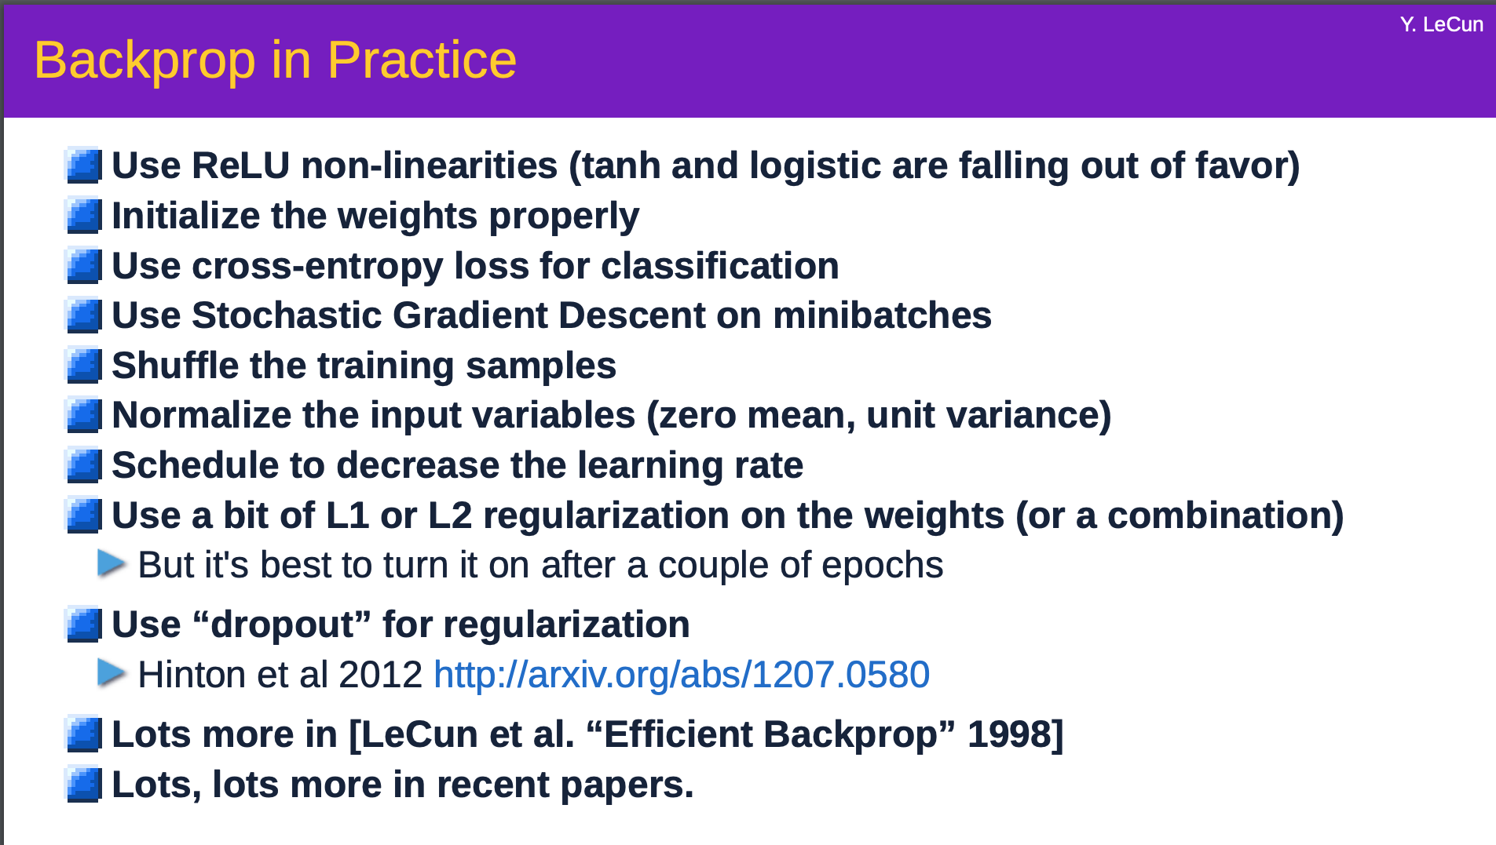

Slide 3
How to use the data?
Data splits
Training / Validation / Testing
More on: https://medium.com/datadriveninvestor/data-science-essentials-why-train-validation-test-data-b7f7d472dc1f
Notes:
Training Testing
If hyper parameter fine-tuning is necessary -> validate on a validation set
Do not test on the testing set!

Slide 4
How to use the data?
Data splits
Training / Validation / Testing
More on: https://medium.com/datadriveninvestor/data-science-essentials-why-train-validation-test-data-b7f7d472dc1f
Notes:
Training Testing
If hyper parameter fine-tuning is necessary -> validate on a validation set
Do not test on the testing set!

Slide 5
How to train a Neural Network
Training loop:
Use training set to learn a model
Evaluate your model on the validation test
Does it perform well enough?
If no, train again using a different strategy (different hyper-parameters); if yes, test (only once)
More on: https://medium.com/datadriveninvestor/data-science-essentials-why-train-validation-test-data-b7f7d472dc1f

Slide 6
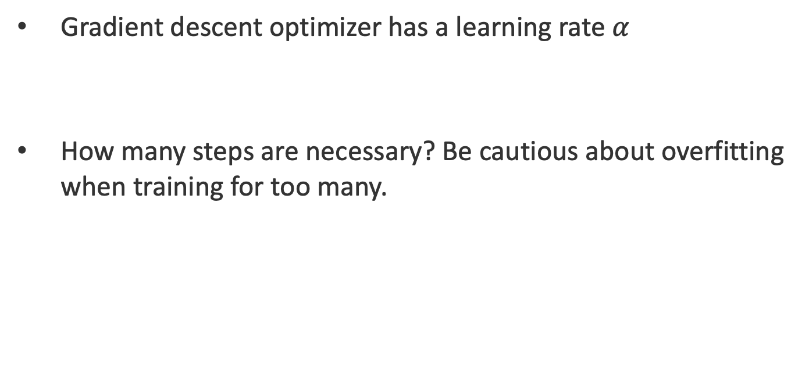
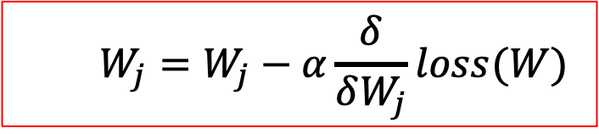
How to train a Neural Network
Gradient descent optimizer has a learning rate $α$
How many steps are necessary? Be cautious about overfitting when training for too many.
$$W_{j}=W_{j}−α\frac{δ}{δW_{j}}loss(W)$$

Slide 7
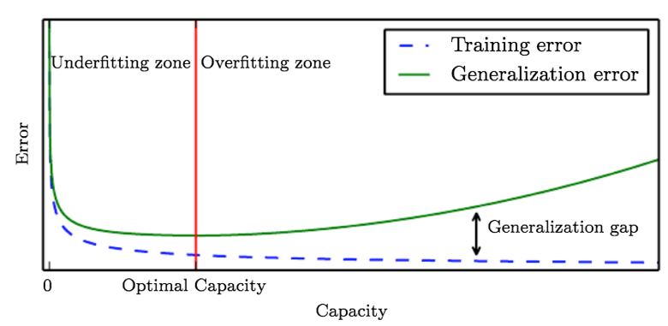
How to train a Neural Network
Overfitting: network is too large, then too complex

Slide 8
How to train a Neural Network
What happen in underfitting/overfitting ?

Slide 9
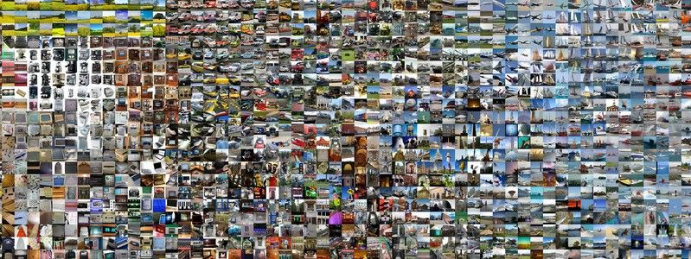
How to train a Neural Network
Overcome overfitting
More training data
Regularization: weight decay, dropout

Slide 10
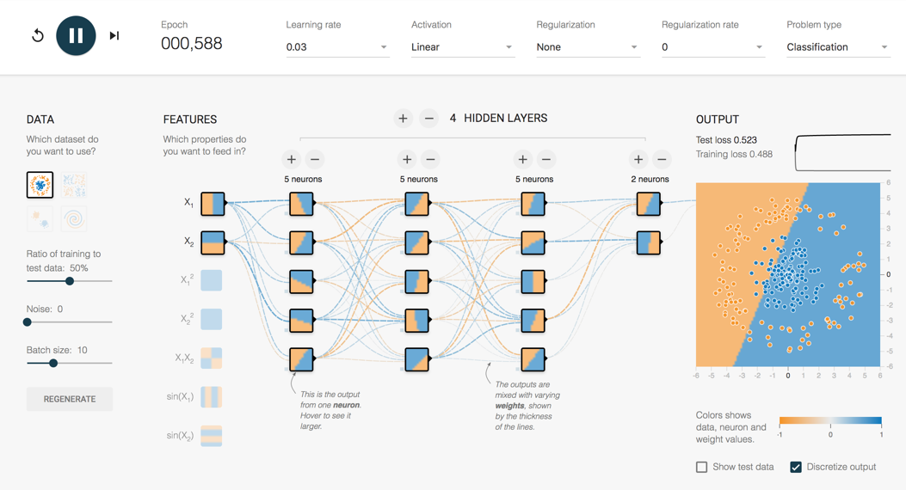
Neural Network
http://playground.tensorflow.org/
Notes:
With linear activation, no matter how many layer you add, there is no way to find a good classifier

Slide 11
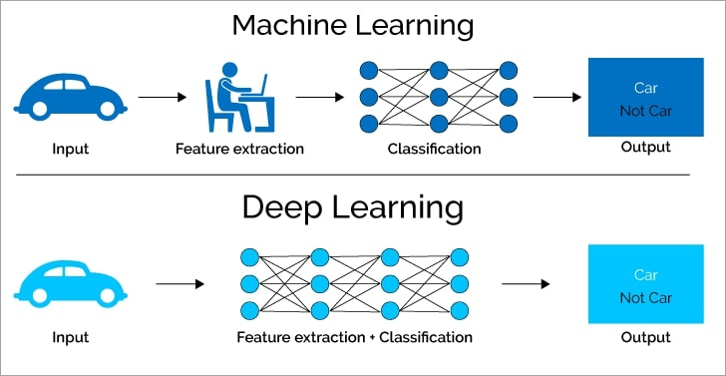
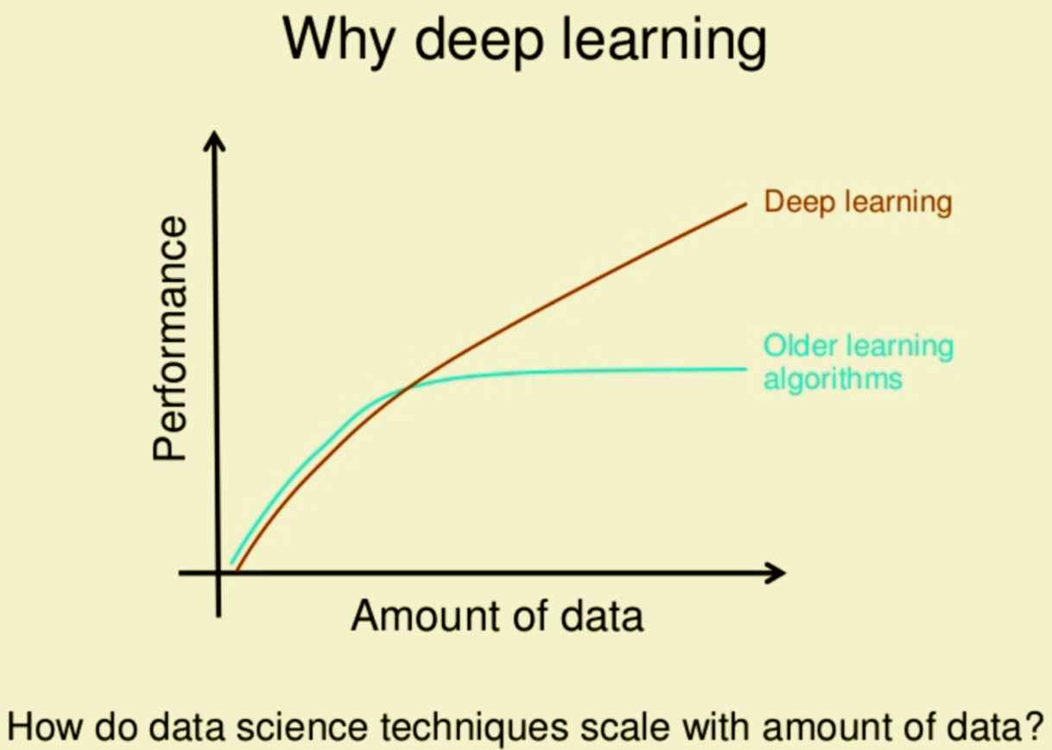
Why going deep?
Brain-like, complex (high capacity)
Much less hand intervention
Notes:
- First and foremost, while traditional machine learning algorithms have a rather simple structure, such as linear regression or a decision tree, deep learning is based on an artificial neural network. This multi-layered ANN is, like a human brain, complex and intertwined.
- Secondly, deep learning algorithms require much less human intervention. Remember the Tesla example? If the STOP sign image recognition was a more traditional machine learning algorithm, a software engineer would manually choose features and a classifier to sort images, check whether the output is as required, and adjust the algorithm if this is not the case. As a deep learning algorithm, however, the features are extracted automatically, and the algorithm learns from its own errors (see image below).

Slide 12
What Going Deep?
We have seen in the universal function approximation of NN that a one hidden layer NN can approximate “any” function
Informally: There are functions you can compute with a “small” L-layer deep neural network that shallower networks require exponentially more hidden units to compute.
Slide from: deeplearning.ai

Slide 13
Deep Neural Network
Re-visit activations
Otherwise, composite of linear operations
Notes:
Linear combination of input will only solve linear problem
Note that SVM will not work in that case

Slide 14
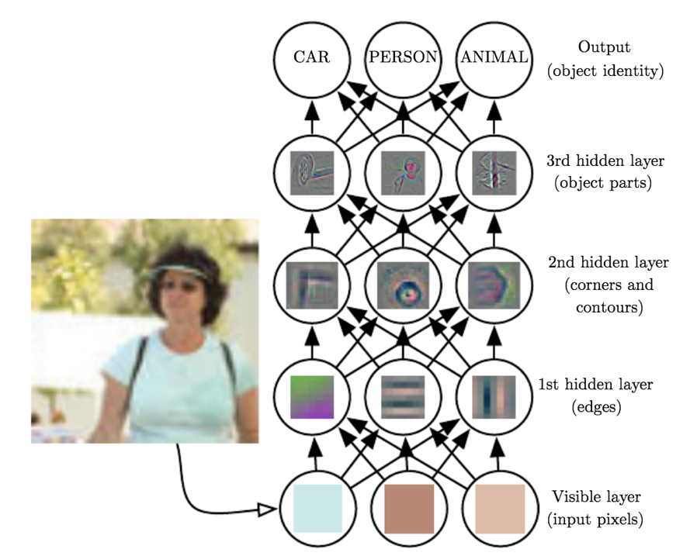
Why going deep?
Complex, learned features
The deeper the more abstract

Slide 15
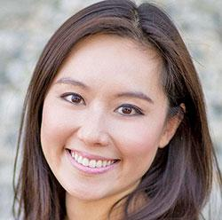
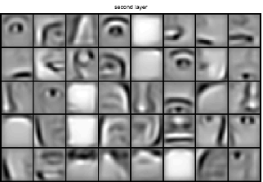
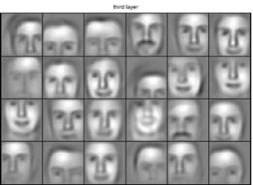
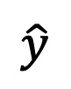
Intuition about deep representation
$$\hat{y}$$

Slide 16
Charts of Neural Networks
Credits: https://towardsdatascience.com/the-mostly-complete-chart-of-neural-networks-explained-3fb6f2367464
Notes:
BREAK

Slide 17
Outline
From machine learning to deep learning
Deep neural network
Train a deep neural network
Convolutional neural networks
Application on computer vision
Notes:
AlphaGo and its successors use a Monte Carlo tree search algorithm to find its moves based on knowledge previously acquired by machine learning, specifically by an artificial neural network (a deep learning method) by extensive training, both from human and computer play.^{[4]} A neural network is trained to identify the best moves and the winning percentages of these moves. This neural network improves the strength of the tree search, resulting in stronger move selection in the next iteration.

Slide 18
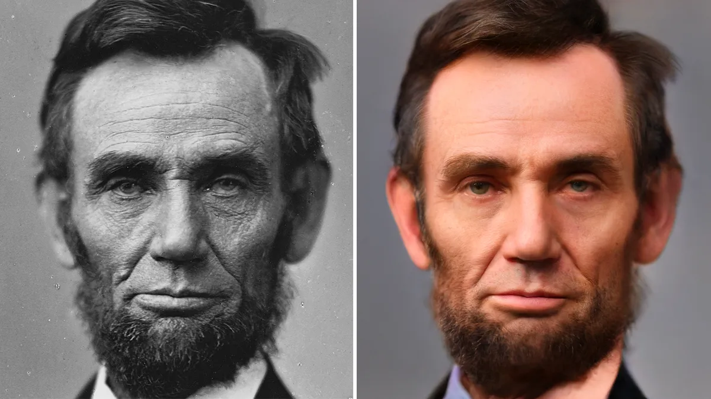
How to represent an image?
Matrix with elements in [0,255]

Slide 19
How to represent an image?
Matrix with elements in [0,255]
Tensor with RGB channels, each being a matrix

Slide 20
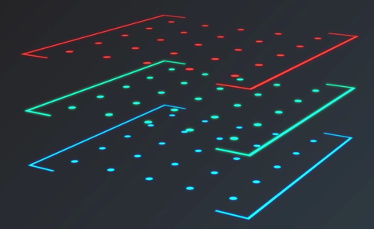
How to represent an image?
Grayscale images are matrices
Color images are Tensors

Slide 21

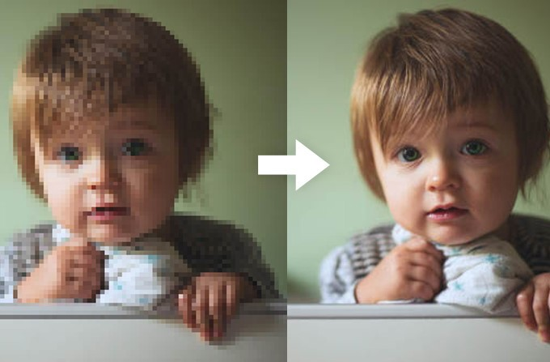
What is Deep Learning?
Input
Deep neural network
Output
Classfication
Regression

Slide 22
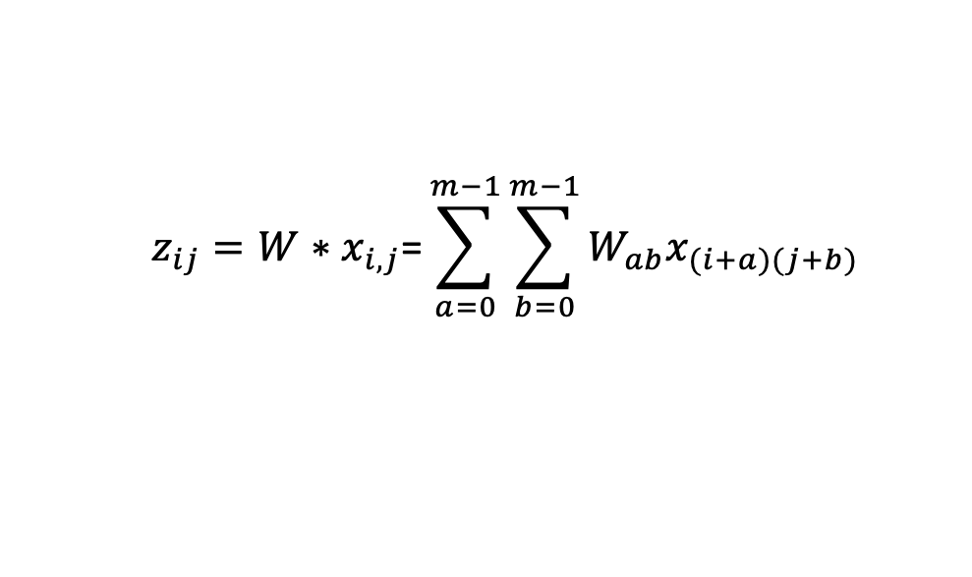
Convolutional Neural Network (CNN)
Full-connected network
Convolutional network
$$z_{ij}=W∗x_{i,j}\text{=}{\sum_{a=0}^{m−1}{\sum_{b=0}^{m−1}{W_{ab}x_{(i+a)(j+b)}}}}_{}$$
$$z=W_{1}x_{1}+W_{2}x_{2}+…+W_{n}x_{n}+b$$
Notes:
FC:
Complex: many parameters
Not consider locality of images
Not reuse weights

Slide 23
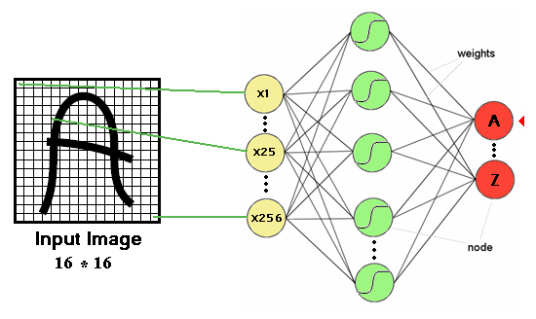
Multi-layer perceptron and image processing
One or more hidden layers
Sigmoid activations functions
Multi-layer perecptron is another name for Neural Networks
Slides from Abin - Roozgard

Slide 24
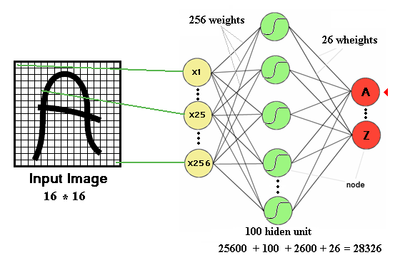
Drawbacks of previous neural networks
the number of trainable parameters becomes extremely large
Slides from Abin - Roozgard

Slide 25
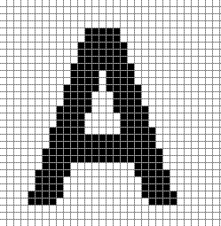
Drawbacks of previous neural networks
Little or no invariance to shifting, scaling, and other forms of distortion
Slides from Abin - Roozgard

Slide 26
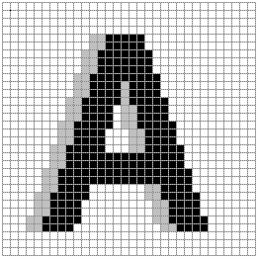
Drawbacks of previous neural networks
Little or no invariance to shifting, scaling, and other forms of distortion
Shift left
Slides from Abin - Roozgard

Slide 27
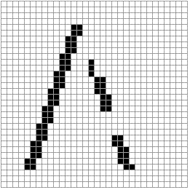
Drawbacks of previous neural networks
154 input change from 2 shift left
77 : black to white
77 : white to black
Slides from Abin - Roozgard

Slide 28
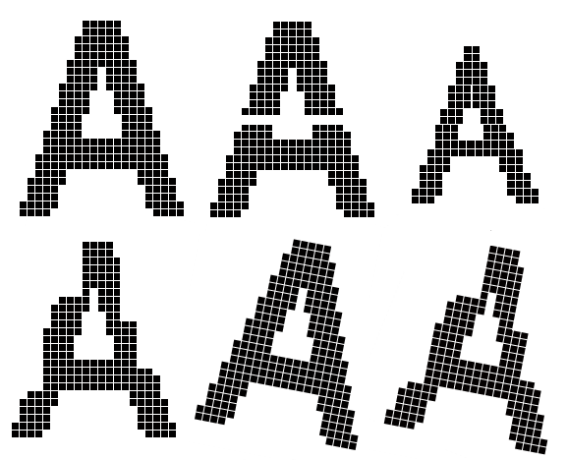
Drawbacks of previous neural networks
scaling, and other forms of distortion
Slides from Abin - Roozgard

Slide 29
Drawbacks of previous neural networks
the topology of the input data is completely ignored
work with raw data.
Feature 1
Feature 2
Slides from Abin - Roozgard

Slide 30
Drawbacks of previous neural networks
Black and white patterns:
Gray scale patterns :
32 * 32 input image
Slides from Abin - Roozgard

Slide 31
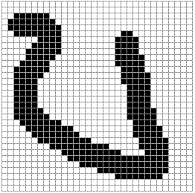
Drawbacks of previous neural networks
A
A
Slides from Abin - Roozgard

Slide 32
Improvement
Fully connected network of sufficient size can produce outputs that are invariant with respect to such variations.
Training time
Network size
Free parameters
Slides from Abin - Roozgard

Slide 33
Convolutional Neural Network (CNN)
Convolutional network
Local connectivity
Reuse parameters
$$z_{ij}=W∗x_{i,j}\text{=}{\sum_{a=0}^{m−1}{\sum_{b=0}^{m−1}{W_{ab}x_{(i+a)(j+b)}}}}_{}$$
Slides from Abin - Roozgard
Notes:
FC:
Complex: many parameters
Not consider locality of images
Not reuse weights

Slide 34
Convolutional Neural Network
How Convolution works
Filters / Padding / Stride
Activations
Pooling Layers

Slide 35
How Convolution works
Convolution on an image
Notes:
More on: https://medium.com/@ageitgey/machine-learning-is-fun-part-3-deep-learning-and-convolutional-neural-networks-f40359318721

Slide 36
How Convolution works
Break the image in overlapping tiles

Slide 37
How Convolution works
Feed each image tile into small NN

Slide 38
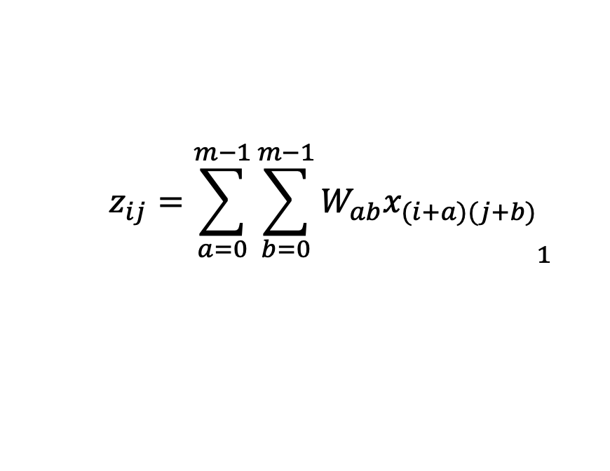
How Convolution works
Store results from each tile into a new array
$$z_{ij}={\sum_{a=0}^{m−1}{\sum_{b=0}^{m−1}{W_{ab}x_{(i+a)(j+b)}}}}_{1}$$
Filter/kernel

Slide 39

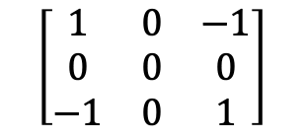
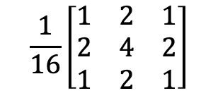
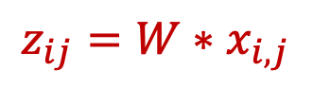
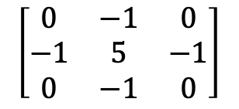
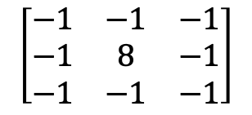
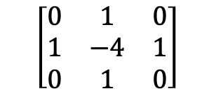
CNN – Filters
$$z_{ij}=W∗x_{i,j}$$
Filters and convolution
$$\left[\begin{matrix}1 & 0 & −1 \\ 0 & 0 & 0 \\ −1 & 0 & 1\end{matrix}\right]$$
$$\left[\begin{matrix}0 & 1 & 0 \\ 1 & −4 & 1 \\ 0 & 1 & 0\end{matrix}\right]$$
$$\left[\begin{matrix}−1 & −1 & −1 \\ −1 & 8 & −1 \\ −1 & −1 & −1\end{matrix}\right]$$
$$\left[\begin{matrix}0 & −1 & 0 \\ −1 & 5 & −1 \\ 0 & −1 & 0\end{matrix}\right]$$
$$\frac{1}{16}\left[\begin{matrix}1 & 2 & 1 \\ 2 & 4 & 2 \\ 1 & 2 & 1\end{matrix}\right]$$
Multiple filters

Slide 40

CNN – Filters
Multiple channels
Ex: RGB color

Slide 41


CNN - Padding
What happen to the borders?
Reduce size of the output
Pad the picture with zeros (zero-padding)
More on: http://deeplearning.net/software/theano/tutorial/conv_arithmetic.html
Notes:
https://medium.com/machine-learning-world/convolutional-neural-networks-for-all-part-ii-b4cb41d424fd

Slide 42

CNN – Strides
If not need to keep all output
Skip some pixels
Stride: number of skipped pixels
Output with smaller resolution
More on: http://deeplearning.net/software/theano/tutorial/conv_arithmetic.html
Notes:
\Not Moving???

Slide 43
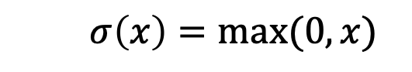
CNN – Activations
Any previous activation fits
Breaks linearity
Ex: Rectified Linear Unit (ReLU)
$$σ\left(x\right)=max⁡(0,x)$$

Slide 44
CNN – Pooling Layer
Max / Mean / Sum Pooling
Reduce the resolution
Notes:
Non linear filtering

Slide 45
A convolution layer
Convolution
Activation
Pooling
Filter
Padding
Stride

Slide 46
Deep Convolutional network
Multiple convolutional layers

Slide 47
Deep Convolutional network
Add redundancy to the network
A way of regularization
Training
Testing
Notes:
Non linear filtering

Slide 48
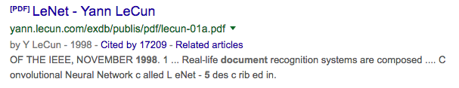
CNN – Most notable network
LeNet-5 (1998)
2 convolutional layers, 2 pooling layers,2 fully connected layers
Used for handwritten numbers on checks

Slide 49
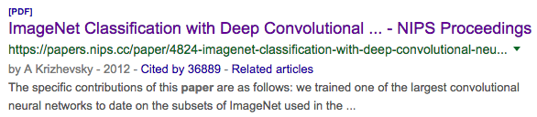
CNN – Most notable network
AlexNet (2012)
First big improvement in image classification
CNN / MaxPool / Dropout / ReLU
5 convolutional layers, followed by max-pooling layers; the last three are fully connected layers

Slide 50
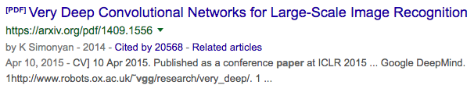
CNN – Most notable network
VGGNet-16 (2014)
13 convolutional layers, 3 fully-connected layers

Slide 51
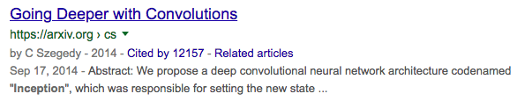
CNN – Most notable network
GoogleNet/Inception (2014)
Going Deep: 22 layers
Very small convolutions
Drastically reduce the number of parameters
From 138M (VGG) to 4M parameters

Slide 52
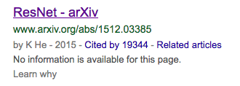
CNN – Most notable network
ResNet (2015)
Residual layer
Up to 152 layers (50-101-152)
Requires huge resources

Slide 53
CNN – Most notable network
Totally more than 100 K citations

Slide 54
Outline
From machine learning to deep learning
Deep neural network
Train a deep neural network
Convolutional neural networks
Application on computer vision
Notes:
AlphaGo and its successors use a Monte Carlo tree search algorithm to find its moves based on knowledge previously acquired by machine learning, specifically by an artificial neural network (a deep learning method) by extensive training, both from human and computer play.^{[4]} A neural network is trained to identify the best moves and the winning percentages of these moves. This neural network improves the strength of the tree search, resulting in stronger move selection in the next iteration.

Slide 55
Application on Computer Vision

Slide 56
Application on Computer Vision
Classification
Notes:
Classification

Slide 57
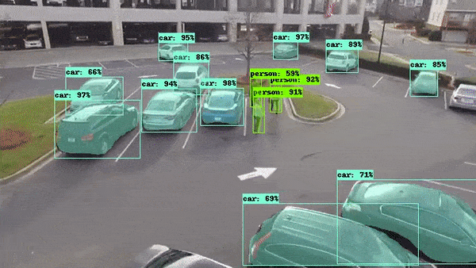
Application on Computer Vision
Object detection
Notes:
Detection in time

Slide 58
Application on Computer Vision
Semantic segmentation
Notes:
Segmentation

Slide 59
Application on Computer Vision
Instance segmentation
Notes:
Detection

Slide 60
Application on Computer Vision
Image super-resolution

Slide 61
Dataset and Challenges
MNIST
Digit Classification (handwritten)
Grayscale intensity from 0 to 255
28 x 28 = 768 pixels
10 classes
10,000 images
Notes:
Used in the afternoon

Slide 62
Dataset and Challenges
CIFAR-10
Object Classification
3 RGB channels from 0 to 255
32 x 32 = 1024 pixels
10 classes
60,000 images

Slide 63
Dataset and Challenges
ImageNet
Object Classification
3 RGB channels from 0 to 255
Any resolution
1000 classes
14,197,122 images

Slide 64
Dataset and Challenges
Pascal VOC (2007)
Object Detection
9,963 images
24,640 annotated objects

Slide 65
Dataset and Challenges
Pascal VOC (2012)
Object Segmentation
11,530 images
27,450 objects
6,929 segmentations

Slide 66
Image Classification – Applications
Image/Photo search (Google Lens)

Slide 67
Image Classification – Applications
Agriculture
PlantNet Plant Identification

Slide 68
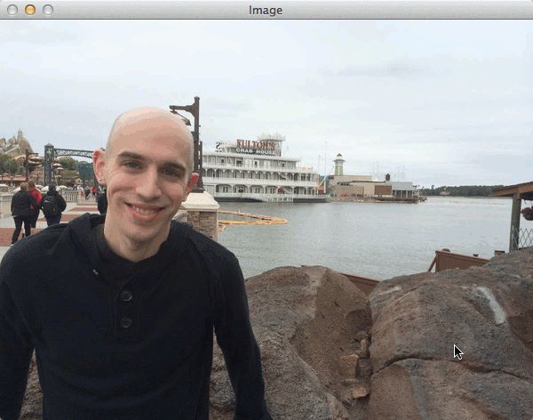
Object Localization
Detection as a classification
Sliding window

Slide 69
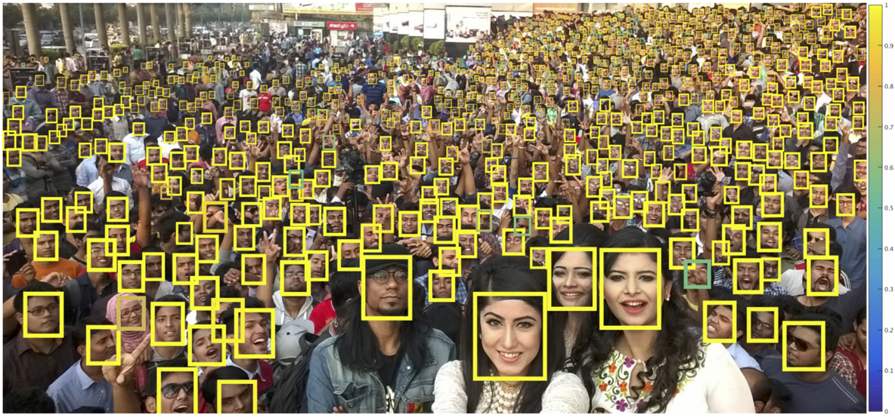
Object Localization - Application
Finding tiny faces in the wild

Slide 70
Object Detection
Faster R-CNN
Propose objects
More on: https://towardsdatascience.com/r-cnn-fast-r-cnn-faster-r-cnn-yolo-object-detection-algorithms-36d53571365e

Slide 71
Object Detection
Faster RCNN
Propose objects
Classify the proposals
Regress the proposals
More on: https://towardsdatascience.com/r-cnn-fast-r-cnn-faster-r-cnn-yolo-object-detection-algorithms-36d53571365e

Slide 72
Object Detection
Faster RCNN
Propose objects
Classify the proposals
Regress the proposals
More on: https://towardsdatascience.com/r-cnn-fast-r-cnn-faster-r-cnn-yolo-object-detection-algorithms-36d53571365e

Slide 73
Object Detection
Faster RCNN
Propose objects
Classify the proposals
Regress the proposals
More on: https://towardsdatascience.com/r-cnn-fast-r-cnn-faster-r-cnn-yolo-object-detection-algorithms-36d53571365e

Slide 74
Object Detection – Application
Drone Application
Parking Lot Vehicle Detection Using DL
More on: https://medium.com/geoai/parking-lot-vehicle-detection-using-deep-learning-49597917bc4a

Slide 75
Object Detection – Application
Agriculture:
Early plant disease detection
More on: https://phys.org/news/2017-04-drones-early-disease-crops.html#jCp

Slide 76
Image Segmentation
SegNet

